Slide 1
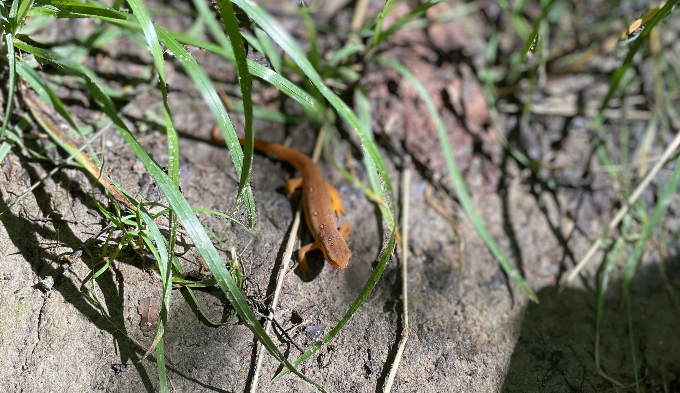
Uh oh…
Unit 6 – Normal Distribution, Sampling Dists and CLT, Day 2
Your Preaching Professor Colton

Slide 2
Unit 6, Day 2 - Outline
Unit 6 – Normal Distribution, Sampling Dists and CLT
Means
Sampling Distributions
Central Limit Theorem
Examples of Problems requiring CLT
Then repeat for Proportions

Slide 3
Good and the Bad...
The Good News
Nothing but Normal probability/percentile questions (no new tools to learn)!
The Bad News
Hard to distinguish today’s material from Tuesday’s!

Slide 4

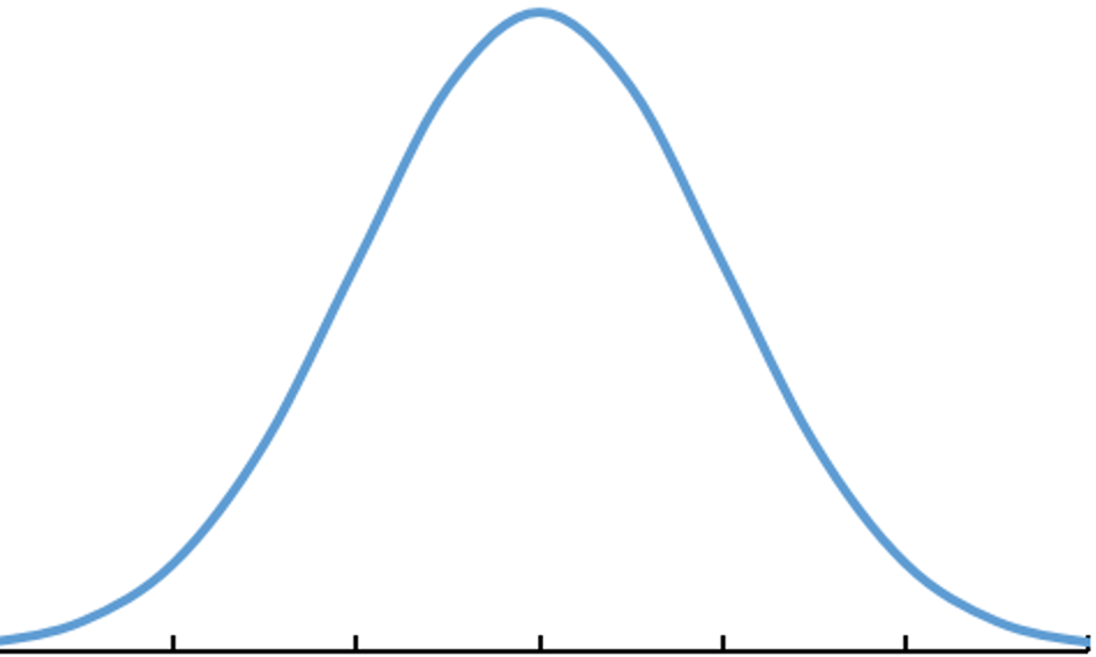
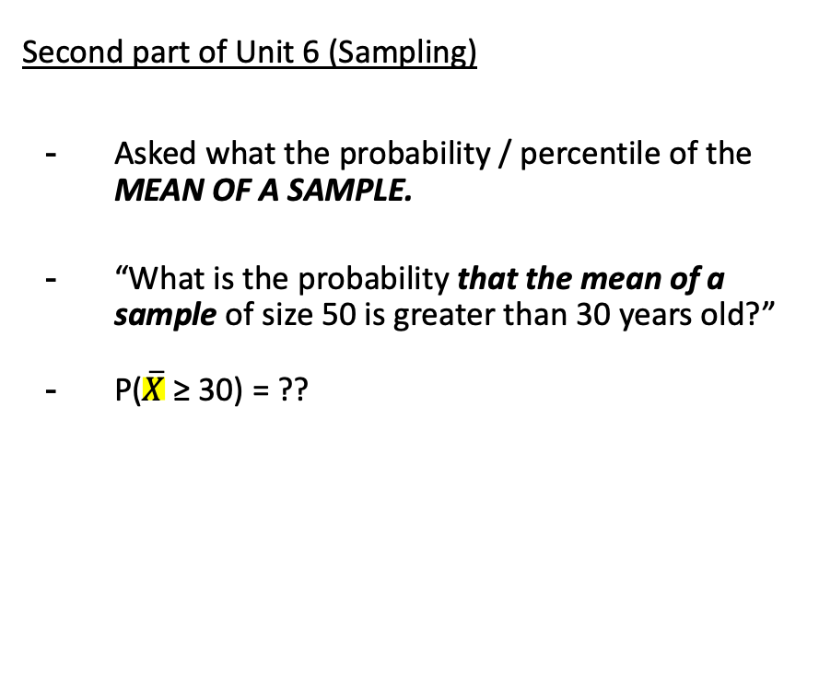
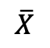
Population Distribution vs. Sampling Distribution
There is a subtle difference between the types of questions we can ask for finding probabilities and percentiles!
First part of Unit 6 (Sample)
Asked what the probability / percentile of an INDIVIDUAL observation.
“What is the probability that an individual player selected at random is above 30 years old?”
P(X ≥ 30) = ??
Second part of Unit 6 (Sampling)
Asked what the probability / percentile of the MEAN OF A SAMPLE.
“What is the probability that the mean of a sample of size 50 is greater than 30 years old?”
P($\overline{X}$ ≥ 30) = ??
X
$$\overline{X}$$

Slide 5
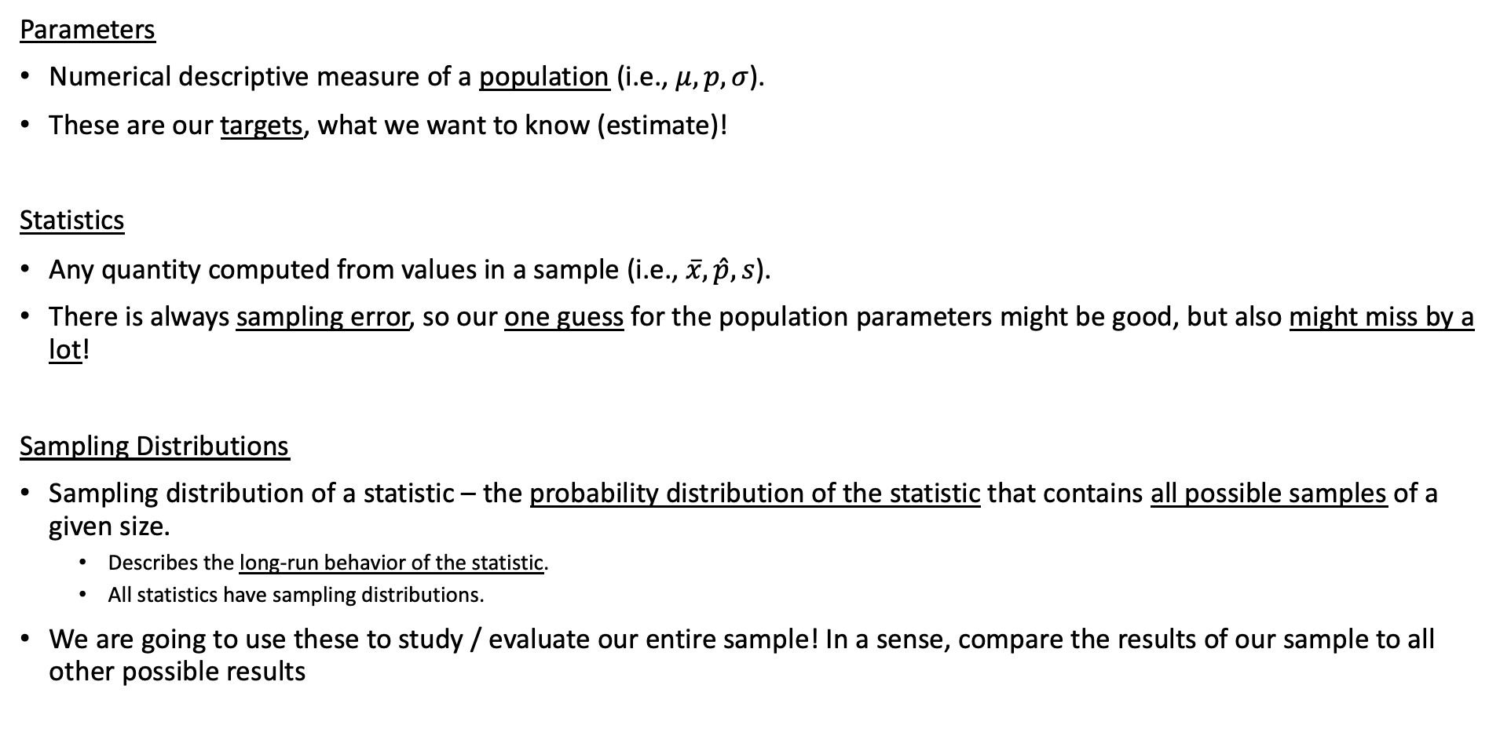
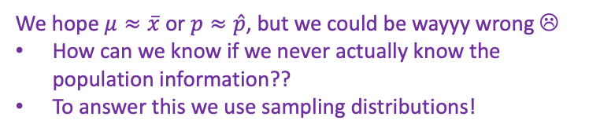
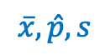
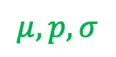
Review + New
Population
Sample
$$μ, p, σ$$
$$\overline{x}, \hat{p}, s$$
Parameters
Numerical descriptive measure of a population (i.e., $μ, p, σ$).
These are our targets, what we want to know (estimate)!
Statistics
Any quantity computed from values in a sample (i.e., $\overline{x},\hat{p}, s$).
There is always sampling error, so our one guess for the population parameters might be good, but also might miss by a lot!
Sampling Distributions
Sampling distribution of a statistic – the probability distribution of the statistic that contains all possible samples of a given size.
Describes the long-run behavior of the statistic.
All statistics have sampling distributions.
We are going to use these to study / evaluate our entire sample! In a sense, compare the results of our sample to all other possible results
We hope $μ≈\overline{x}$ or $p≈\hat{p}$, but we could be wayyy wrong ☹
How can we know if we never actually know the population information??
To answer this we use sampling distributions!

Slide 6
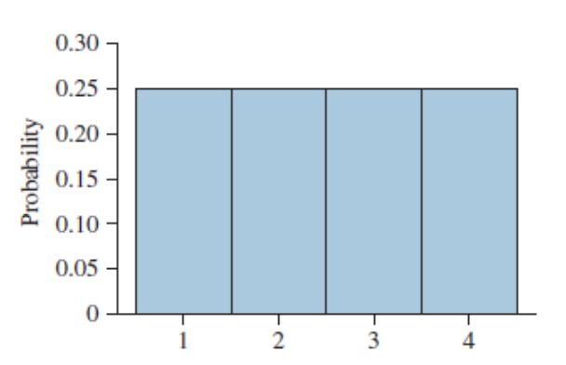
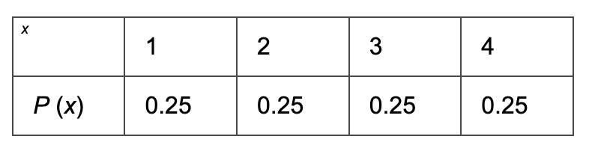
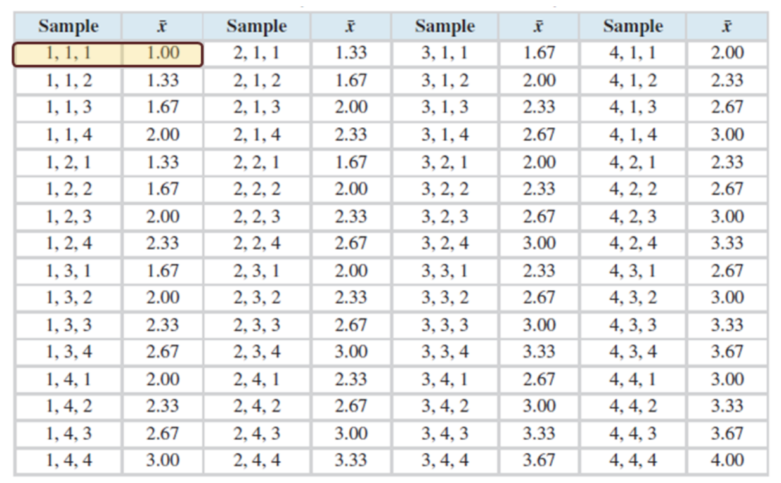
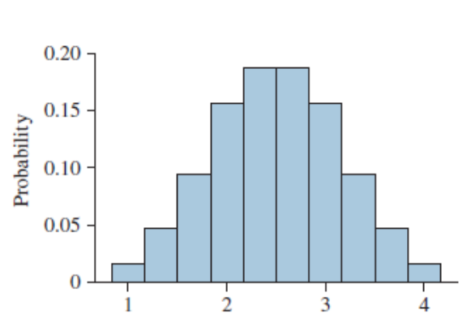
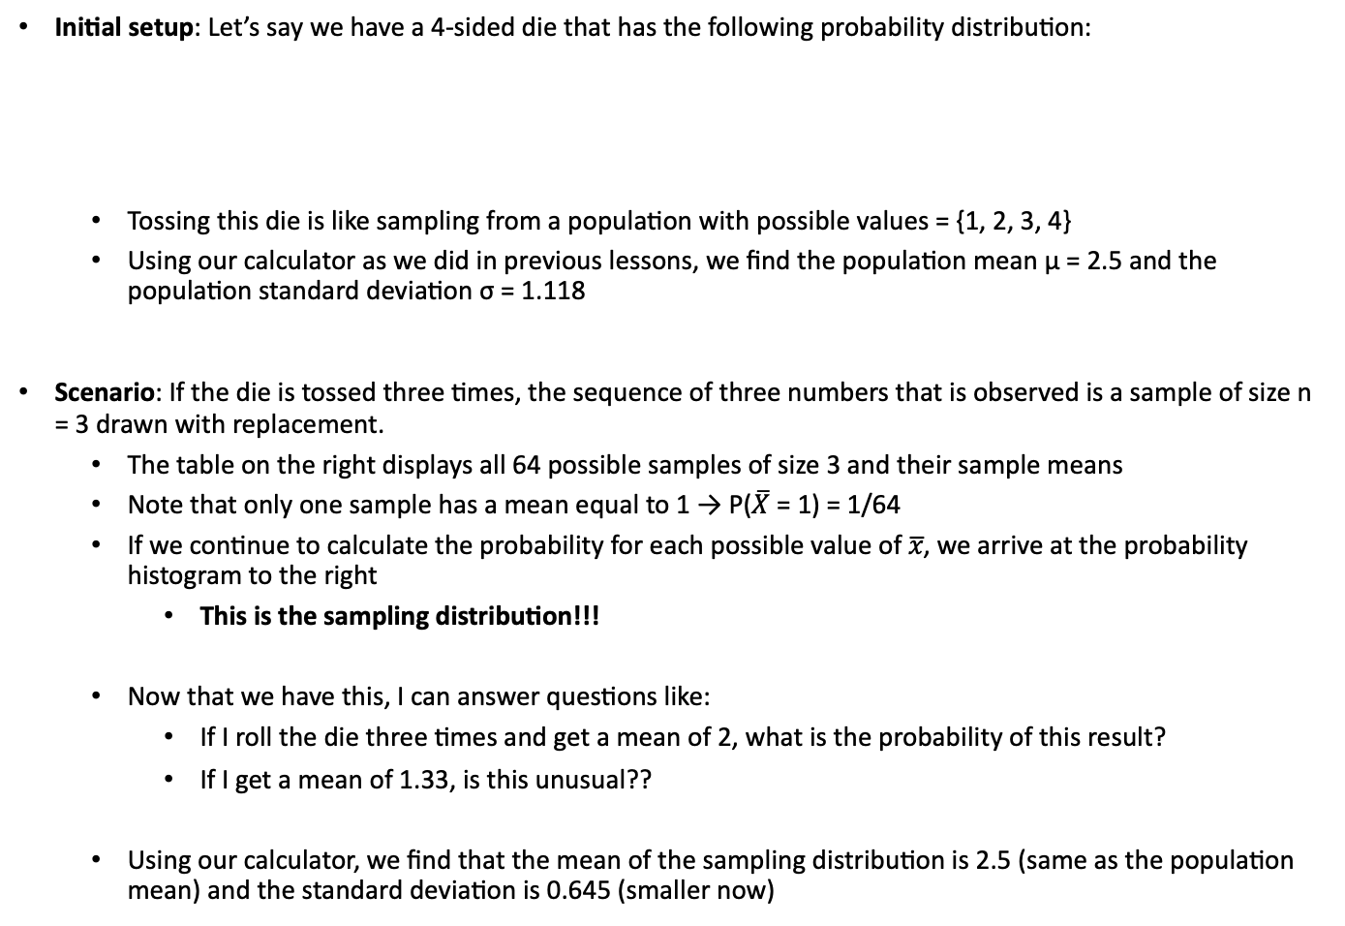
Sampling Distribution Example
Initial setup: Let’s say we have a 4-sided die that has the following probability distribution:
Tossing this die is like sampling from a population with possible values = {1, 2, 3, 4}
Using our calculator as we did in previous lessons, we find the population mean μ = 2.5 and the population standard deviation σ = 1.118
Scenario: If the die is tossed three times, the sequence of three numbers that is observed is a sample of size n = 3 drawn with replacement.
The table on the right displays all 64 possible samples of size 3 and their sample means
Note that only one sample has a mean equal to 1 → P($\overline{X}$ = 1) = 1/64
If we continue to calculate the probability for each possible value of 𝑥̅, we arrive at the probability histogram to the right
This is the sampling distribution!!!
Now that we have this, I can answer questions like:
If I roll the die three times and get a mean of 2, what is the probability of this result?
If I get a mean of 1.33, is this unusual??
Using our calculator, we find that the mean of the sampling distribution is 2.5 (same as the population mean) and the standard deviation is 0.645 (smaller now)

Slide 7
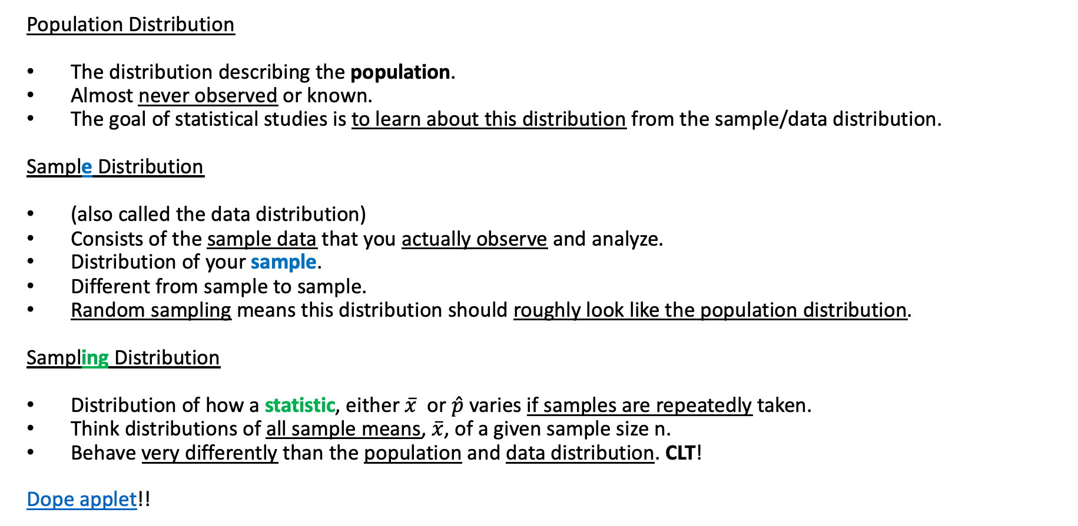
The Three Different Distributions
Population Distribution
The distribution describing the population.
Almost never observed or known.
The goal of statistical studies is to learn about this distribution from the sample/data distribution.
Sample Distribution
(also called the data distribution)
Consists of the sample data that you actually observe and analyze.
Distribution of your sample.
Different from sample to sample.
Random sampling means this distribution should roughly look like the population distribution.
Sampling Distribution
Distribution of how a statistic, either $\overline{x}$or $\hat{p}$ varies if samples are repeatedly taken.
Think distributions of all sample means, $\overline{x}$, of a given sample size n.
Behave very differently than the population and data distribution. CLT!
Dope applet!!

Slide 8
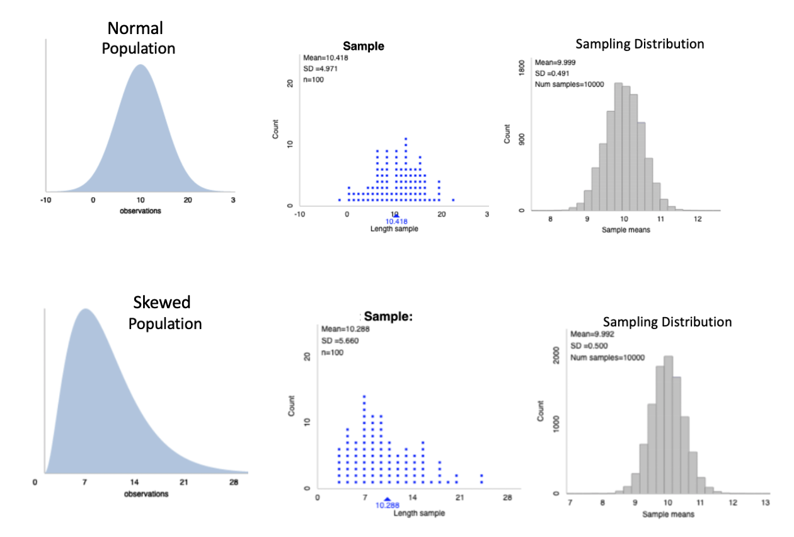
The Three Different Distributions
Dope applet!!

Slide 9
Sample ≠ Sampling
Sample does not mean the same thing as sampling.

Slide 10
Means!

Slide 11
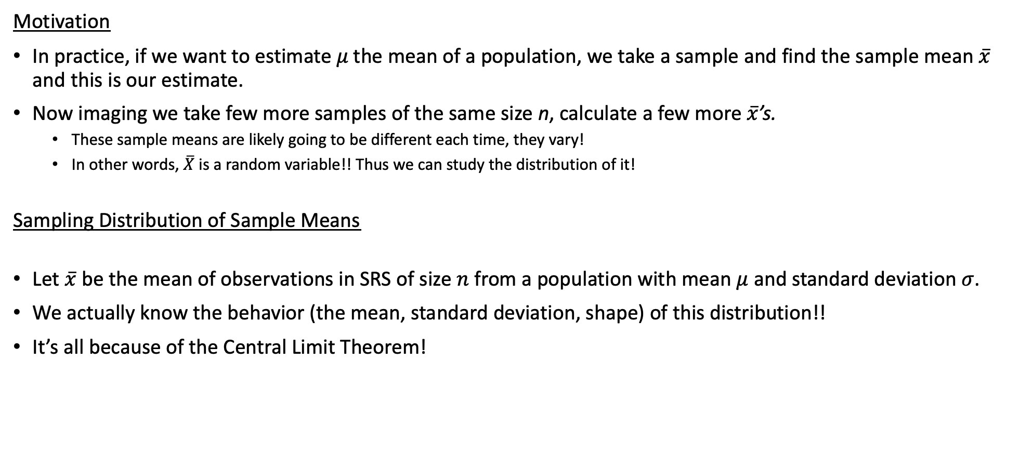
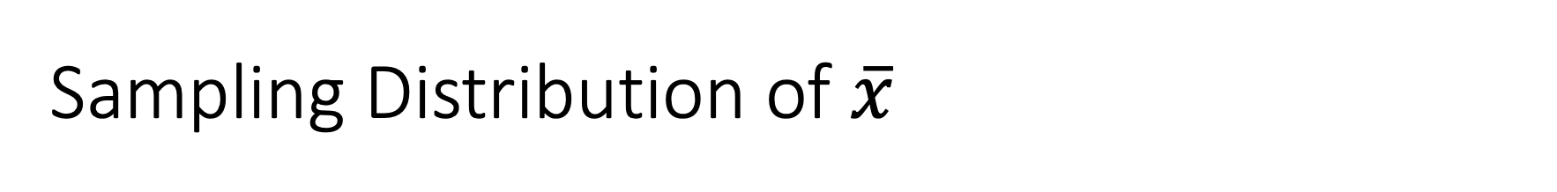
Sampling Distribution of $\overline{x}$
Motivation
In practice, if we want to estimate 𝜇 the mean of a population, we take a sample and find the sample mean $\overline{x}$ and this is our estimate.
Now imaging we take few more samples of the same size n, calculate a few more $\overline{x}$’s.
These sample means are likely going to be different each time, they vary!
In other words, $\overline{X}$ is a random variable!! Thus we can study the distribution of it!
Sampling Distribution of Sample Means
Let $\overline{x}$ be the mean of observations in SRS of size $n$ from a population with mean $μ$ and standard deviation $σ$.
We actually know the behavior (the mean, standard deviation, shape) of this distribution!!
It’s all because of the Central Limit Theorem!

Slide 12
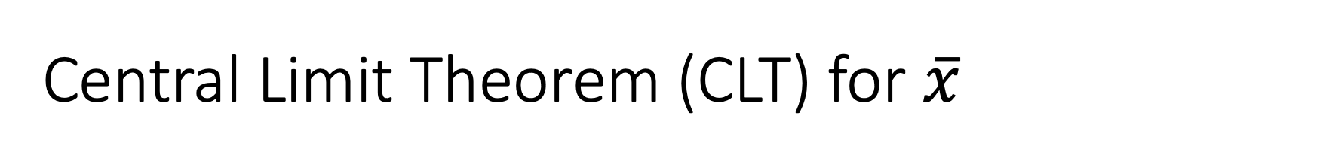
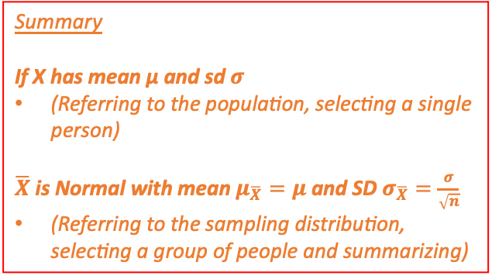
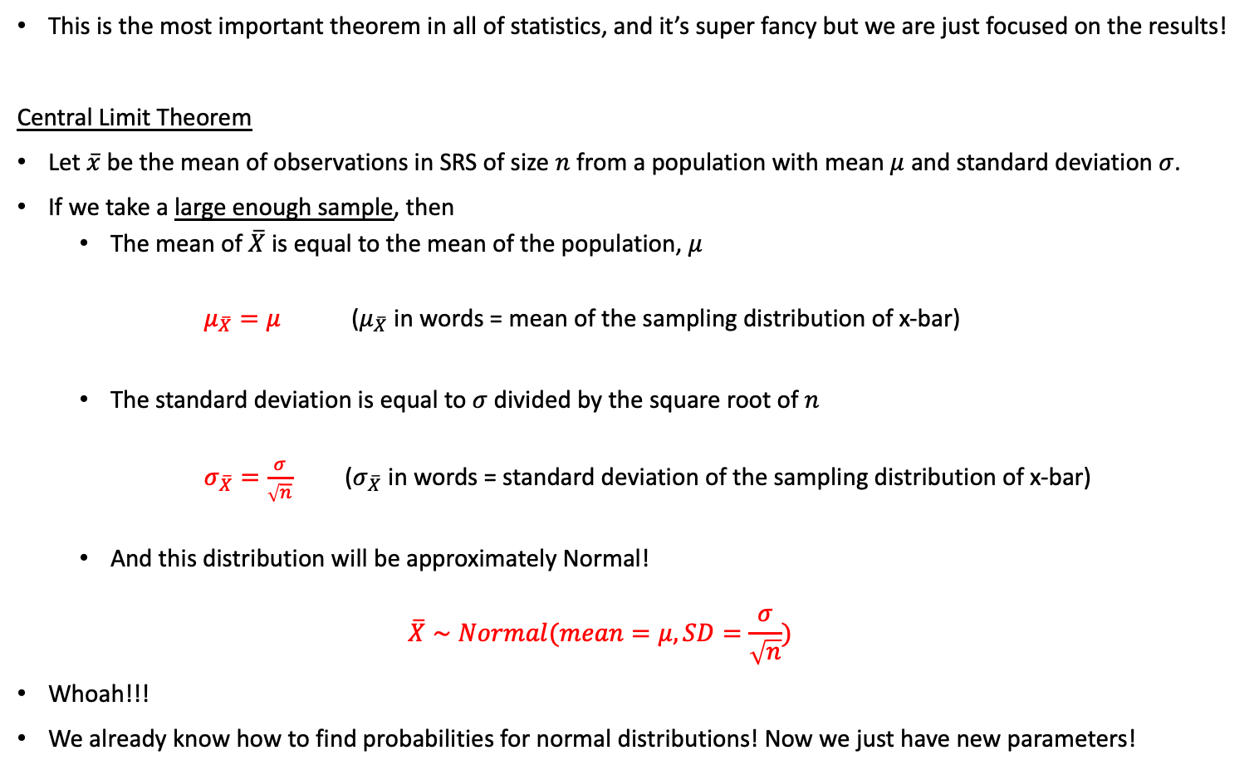
Central Limit Theorem (CLT) for $\overline{x}$
This is the most important theorem in all of statistics, and it’s super fancy but we are just focused on the results!
Central Limit Theorem
Let $\overline{x}$ be the mean of observations in SRS of size $n$ from a population with mean $μ$ and standard deviation $σ$.
If we take a large enough sample, then
The mean of $\overline{X}$ is equal to the mean of the population, $μ$
$μ_{\overline{X}}=μ$ ($μ_{\overline{X}}$ in words = mean of the sampling distribution of x-bar)
The standard deviation is equal to $σ$ divided by the square root of $n$
$σ_{\overline{X}}=\frac{σ}{\sqrt{n}}$ ($σ_{\overline{X}}$ in words = standard deviation of the sampling distribution of x-bar)
And this distribution will be approximately Normal!
$$\overline{X}∼Normal(mean=μ, SD=\frac{σ}{\sqrt{n}})$$
Whoah!!!
We already know how to find probabilities for normal distributions! Now we just have new parameters!
Summary
If X has mean µ and sd $σ$
(Referring to the population, selecting a single person)
$\overline{X}$ is Normal with mean $μ_{\overline{X}}=μ$ and SD $σ_{\overline{X}}=\frac{σ}{\sqrt{n}}$
(Referring to the sampling distribution, selecting a group of people and summarizing)

Slide 13
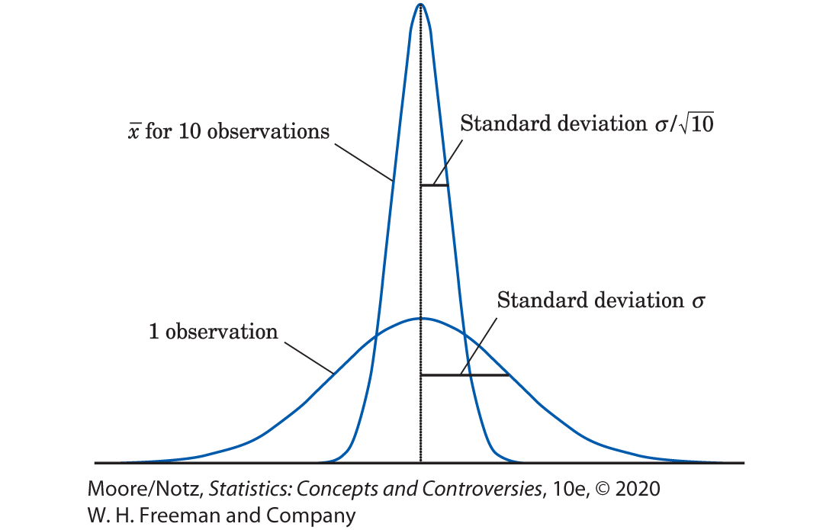
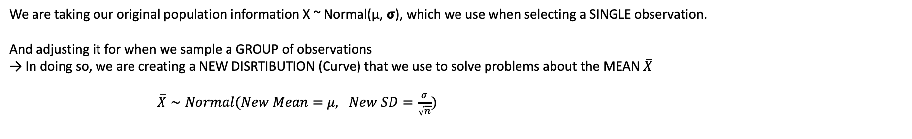
What’s actually happening
We are taking our original population information X ~ Normal(µ, 𝞂), which we use when selecting a SINGLE observation.
And adjusting it for when we sample a GROUP of observations
→ In doing so, we are creating a NEW DISRTIBUTION (Curve) that we use to solve problems about the MEAN $\overline{X}$
$\overline{X}∼Normal(New Mean=μ, New SD=\frac{σ}{\sqrt{n}})$
Example – Why is the NEW st dev smaller?
If I ask each of you your GPA…
There will be a lot of variation overall from student to student
Now if I put you in groups of five and each group finds the average GPA…
There will be less variation from group to group compared to overall student to student
Sampling Dist
Population Dist
0 GPA 4

Slide 14
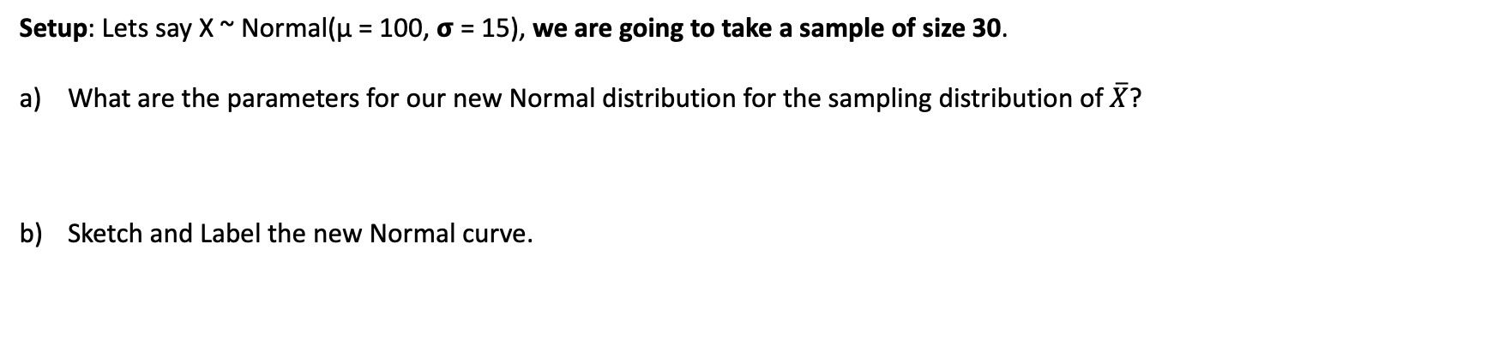
New Normal Calc Fun Sess!: Finding Probabilities based on Distribution of $\overline{X}$
Setup: Lets say X ~ Normal(μ = 100, 𝞂 = 15), we are going to take a sample of size 30.
What are the parameters for our new Normal distribution for the sampling distribution of $\overline{X}$?
Sketch and Label the new Normal curve.

Slide 15
New Normal Calc Fun Sess!: Finding Probabilities based on Distribution of $\overline{X}$
STEP 1: Draw Normal Curve and Label!!! Find new parameters!
STEP 2: Write in terms of a probability statement!!!
STEP 3: Shade the curve
STEP 4: Show work and write answer!
Setup: Lets say X ~ Normal(μ = 100, 𝞂 = 15), we are going to take a sample of size 30.
Now lets find some probabilities!
c) What is the probability a sample mean is less than 104?
d) What is the probability the sample mean is between 95 and 101?
e) What is the probability a randomly selected individual is less than 95?

Slide 16
New Normal Calc Fun Sess!: Finding Percentiles based on Distribution of $\overline{X}$
STEP 1: Draw Normal Curve and Label!!! Find new parameters!
STEP 2: Write in terms of a probability statement!!!
STEP 3: Shade the curve
STEP 4: Show work and write answer!
Setup: Lets say X ~ Normal(μ = 100, 𝞂 = 15), we are going to take a sample of size 30.
Now lets find some percentiles!
f) Find the 45th percentile of sample means = X-bar (sampling distribution)
g) If the sample mean is at the top 15%, what is its value?
e) Which sample means bound the middle 60% of sample means?

Slide 17
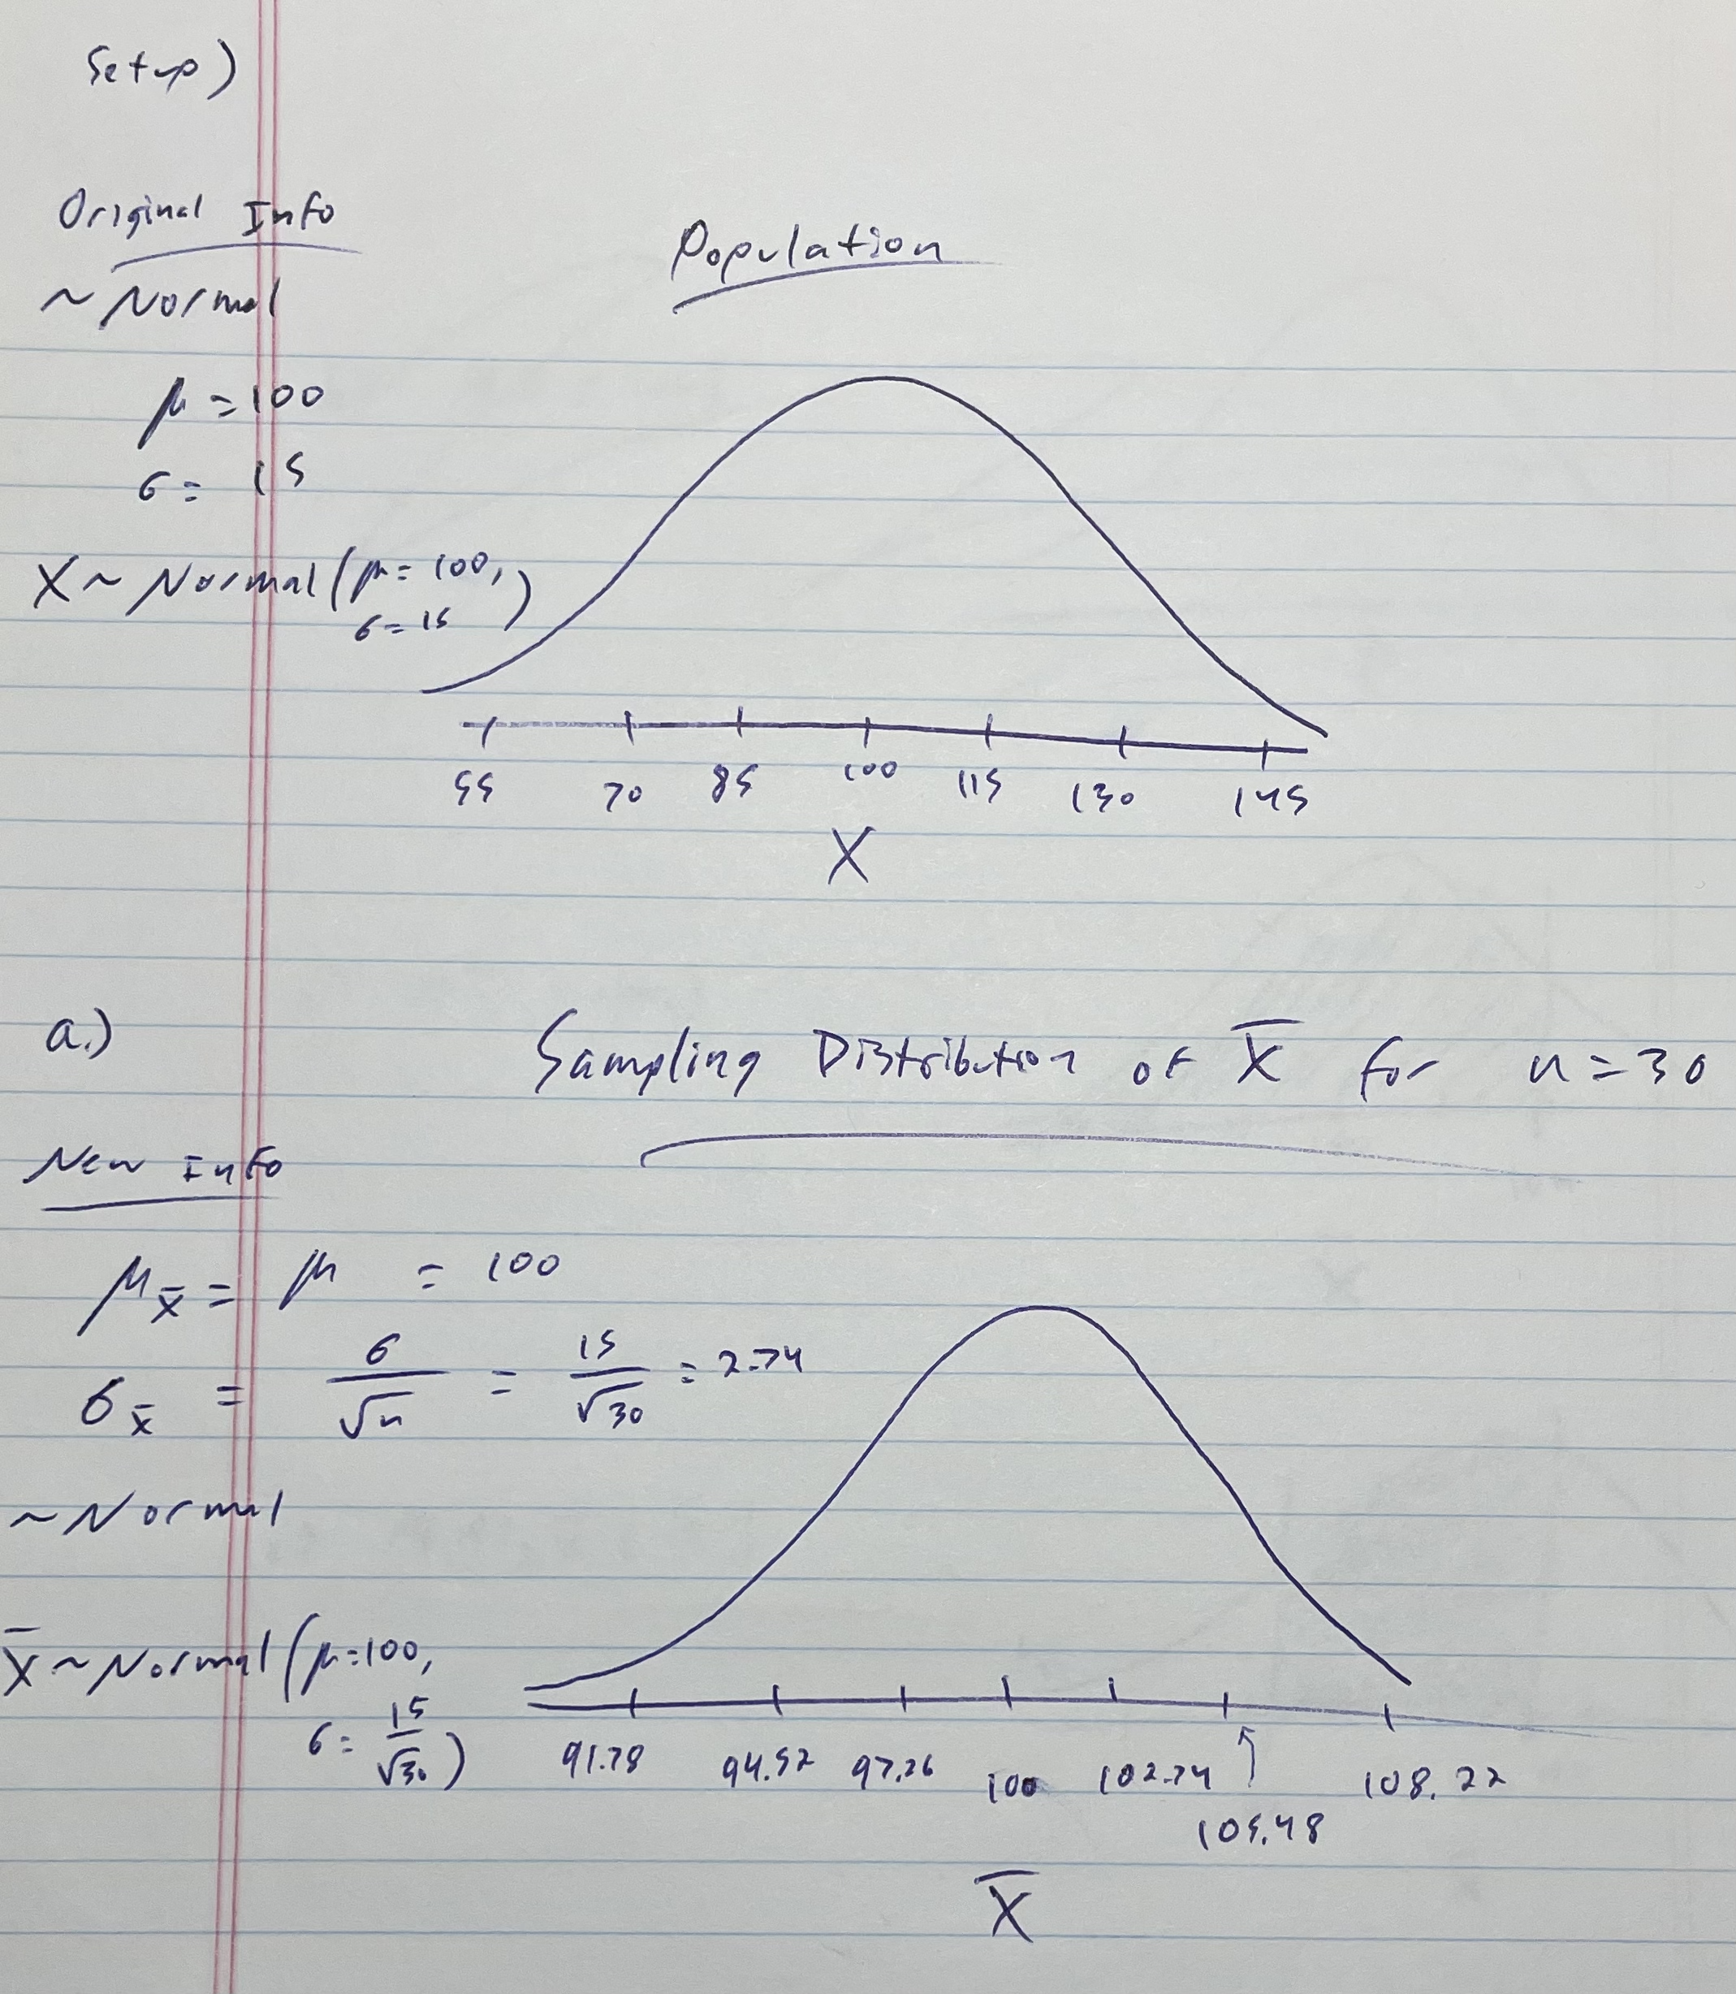
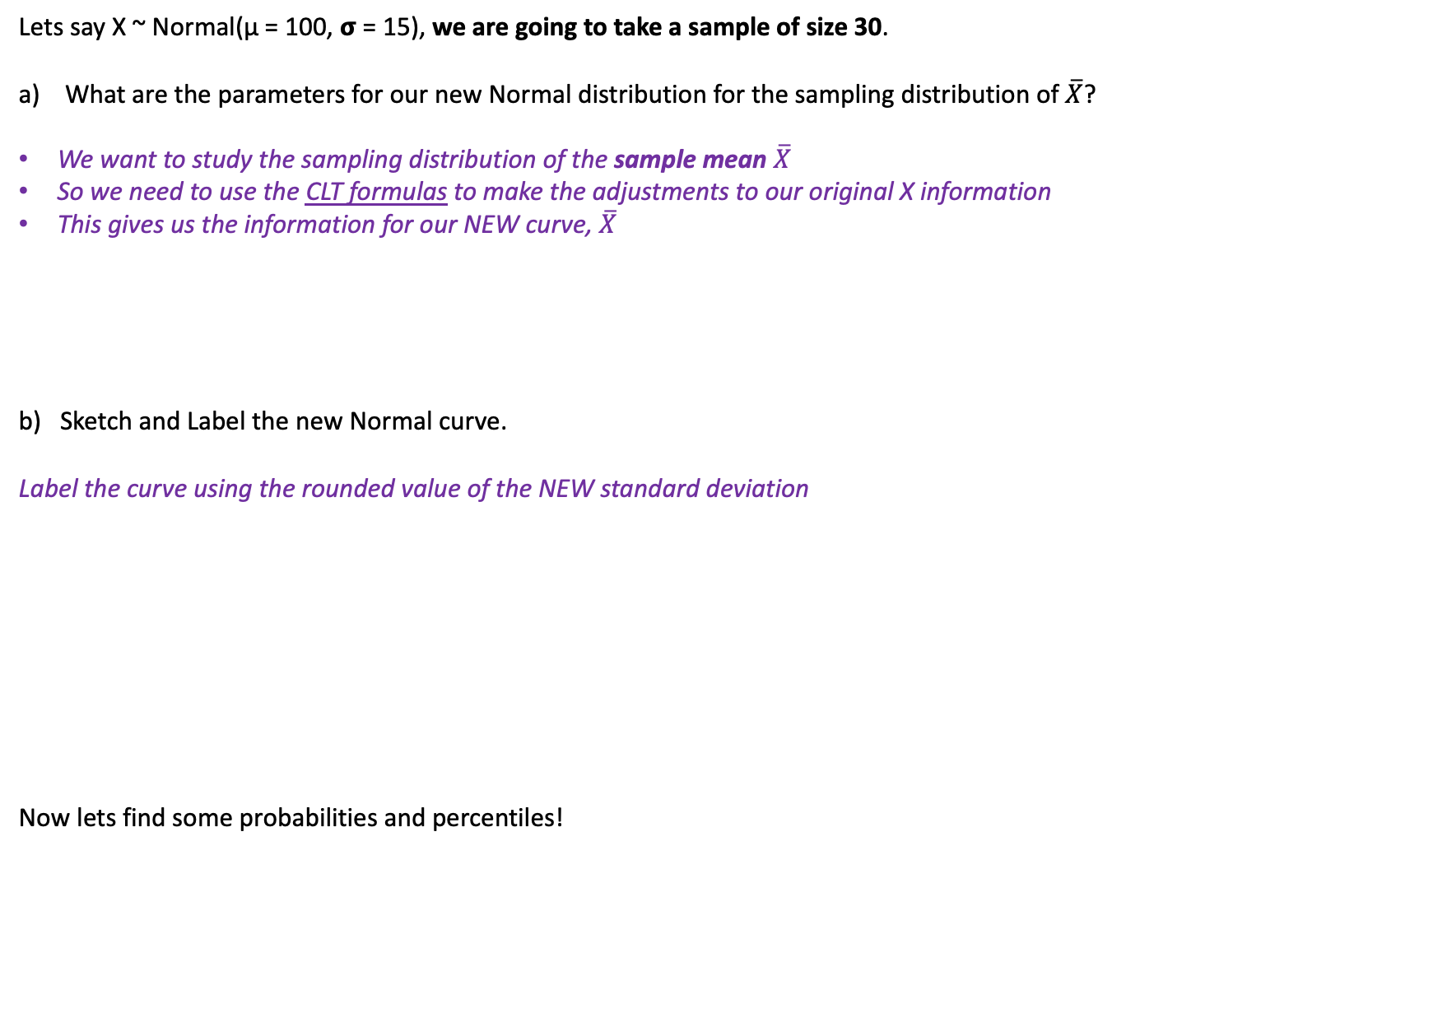
New Normal Calc Fun Sess!: Finding Probabilities based on Distribution of $\overline{X}$
Lets say X ~ Normal(μ = 100, 𝞂 = 15), we are going to take a sample of size 30.
What are the parameters for our new Normal distribution for the sampling distribution of $\overline{X}$?
We want to study the sampling distribution of the sample mean $\overline{X}$
So we need to use the CLT formulas to make the adjustments to our original X information
This gives us the information for our NEW curve, $\overline{X}$
b) Sketch and Label the new Normal curve.
Label the curve using the rounded value of the NEW standard deviation
Now lets find some probabilities and percentiles!
91.78 94.52 97.26 100 102.74 105.48 108.22
$$\overline{X}$$

Slide 18
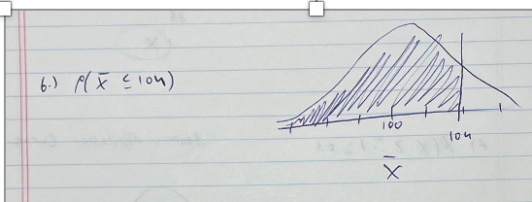
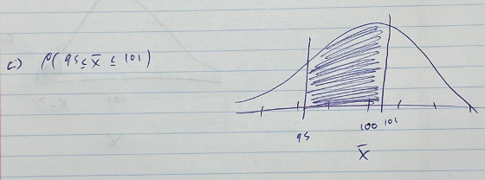
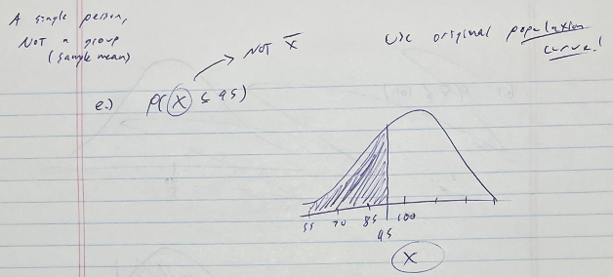
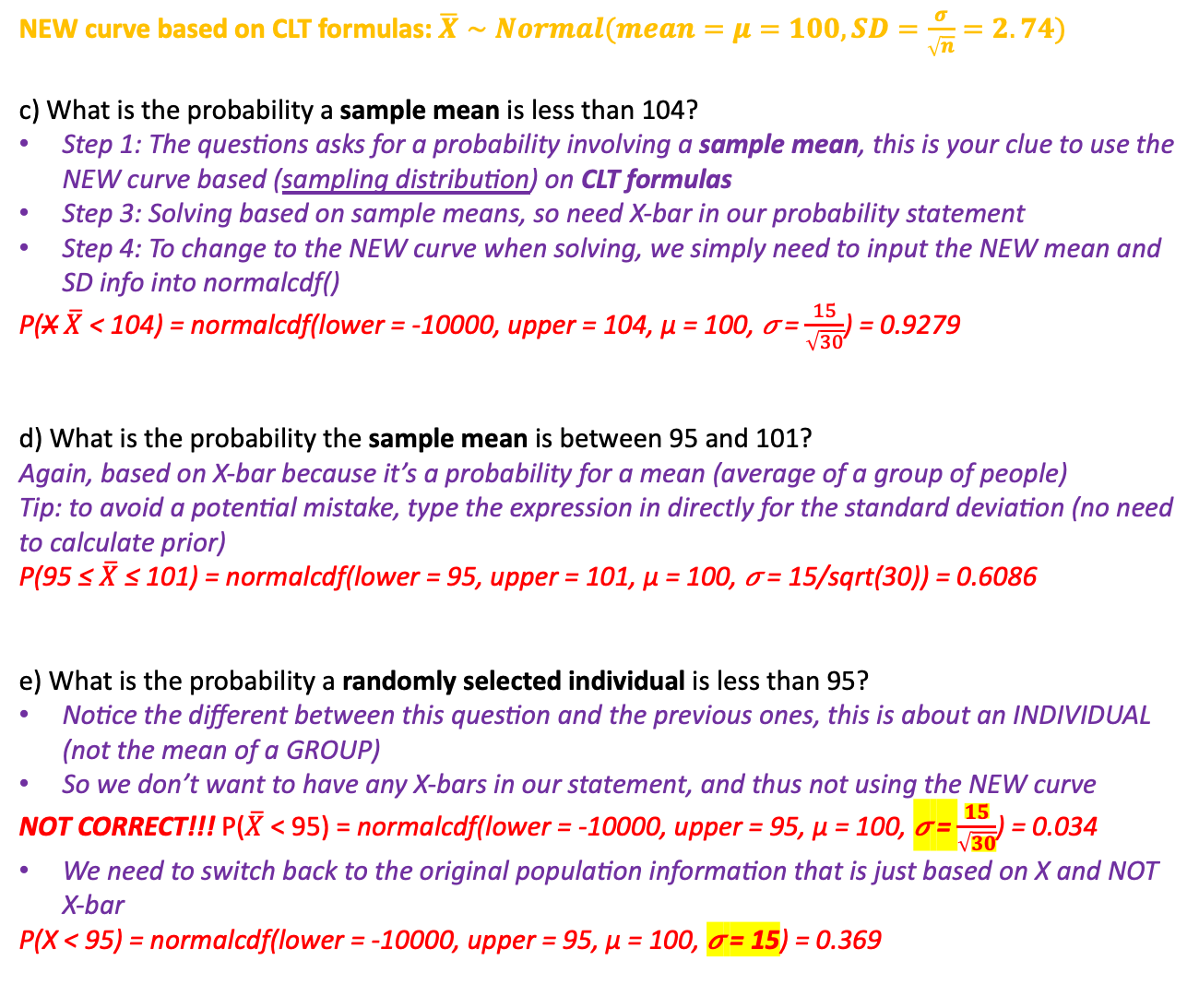
New Normal Calc Fun Sess!: Finding Probabilities based on Distribution of $\overline{X}$
STEP 1: Draw Normal Curve and Label!!! Find new parameters!
STEP 2: Write in terms of a probability statement!!!
STEP 3: Shade the curve
STEP 4: Show work and write answer!
NEW curve based on CLT formulas: $\overline{X}∼Normal(mean=μ=100, SD=\frac{σ}{\sqrt{n}}=2.74)$
c) What is the probability a sample mean is less than 104?
Step 1: The questions asks for a probability involving a sample mean, this is your clue to use the NEW curve based (sampling distribution) on CLT formulas
Step 3: Solving based on sample means, so need X-bar in our probability statement
Step 4: To change to the NEW curve when solving, we simply need to input the NEW mean and SD info into normalcdf()
P(X $\overline{X}$ < 104) = normalcdf(lower = -10000, upper = 104, μ = 100, 𝜎 = $\frac{15}{\sqrt{30}}$) = 0.9279
d) What is the probability the sample mean is between 95 and 101?
Again, based on X-bar because it’s a probability for a mean (average of a group of people)
Tip: to avoid a potential mistake, type the expression in directly for the standard deviation (no need to calculate prior)
P(95 ≤ $\overline{X}$ ≤ 101) = normalcdf(lower = 95, upper = 101, μ = 100, 𝜎 = 15/sqrt(30)) = 0.6086
e) What is the probability a randomly selected individual is less than 95?
Notice the different between this question and the previous ones, this is about an INDIVIDUAL (not the mean of a GROUP)
So we don’t want to have any X-bars in our statement, and thus not using the NEW curve
NOT CORRECT!!! P($\overline{X}$ < 95) = normalcdf(lower = -10000, upper = 95, μ = 100, 𝜎 = $\frac{15}{\sqrt{30}}$) = 0.034
We need to switch back to the original population information that is just based on X and NOT X-bar
P(X < 95) = normalcdf(lower = -10000, upper = 95, μ = 100, 𝜎 = 15) = 0.369

Slide 19
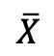



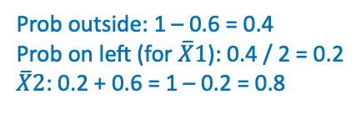
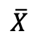
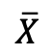
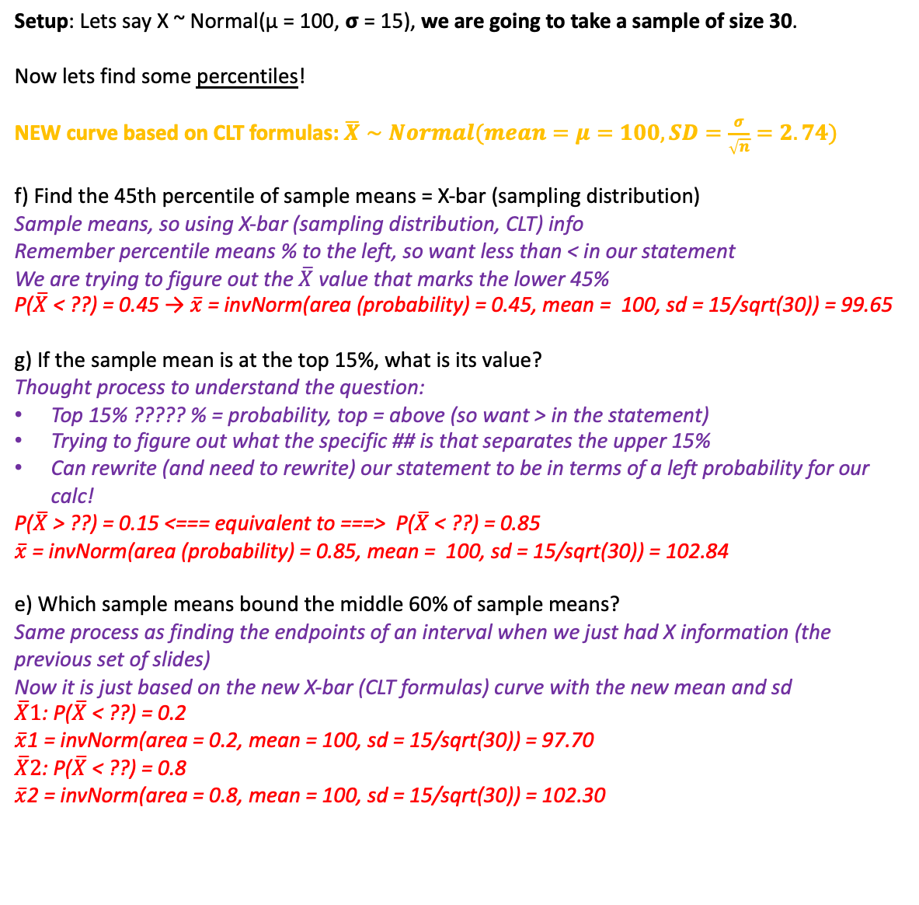
New Normal Calc Fun Sess!: Finding Percentiles based on Distribution of $\overline{X}$
Setup: Lets say X ~ Normal(μ = 100, 𝞂 = 15), we are going to take a sample of size 30.
Now lets find some percentiles!
NEW curve based on CLT formulas: $\overline{X}∼Normal(mean=μ=100, SD=\frac{σ}{\sqrt{n}}=2.74)$
f) Find the 45th percentile of sample means = X-bar (sampling distribution)
Sample means, so using X-bar (sampling distribution, CLT) info
Remember percentile means % to the left, so want less than < in our statement
We are trying to figure out the $\overline{X}$ value that marks the lower 45%
P($\overline{X}$ < ??) = 0.45 → $\overline{x}$= invNorm(area (probability) = 0.45, mean = 100, sd = 15/sqrt(30)) = 99.65
g) If the sample mean is at the top 15%, what is its value?
Thought process to understand the question:
Top 15% ????? % = probability, top = above (so want > in the statement)
Trying to figure out what the specific ## is that separates the upper 15%
Can rewrite (and need to rewrite) our statement to be in terms of a left probability for our calc!
P($\overline{X}$ > ??) = 0.15 <=== equivalent to ===> P($\overline{X}$ < ??) = 0.85
$\overline{x}$= invNorm(area (probability) = 0.85, mean = 100, sd = 15/sqrt(30)) = 102.84
e) Which sample means bound the middle 60% of sample means?
Same process as finding the endpoints of an interval when we just had X information (the previous set of slides)
Now it is just based on the new X-bar (CLT formulas) curve with the new mean and sd
$\overline{X}1$: P($\overline{X}$ < ??) = 0.2
$\overline{x}$1 = invNorm(area = 0.2, mean = 100, sd = 15/sqrt(30)) = 97.70
$\overline{X}2$: P($\overline{X}$ < ??) = 0.8
$\overline{x}$2 = invNorm(area = 0.8, mean = 100, sd = 15/sqrt(30)) = 102.30
STEP 1: Draw Normal Curve and Label!!! Find new parameters!
STEP 2: Write in terms of a probability statement!!!
STEP 3: Shade the curve
STEP 4: Show work and write answer!
100
$$\overline{X}$$
100
$$\overline{X}$$
Prob outside: 1 – 0.6 = 0.4
Prob on left (for $\overline{X}1$): 0.4 / 2 = 0.2
$\overline{X}2$: 0.2 + 0.6 = 1 – 0.2 = 0.8
100
$$\overline{X}$$

Slide 20
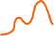
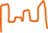
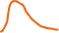
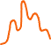
Central Limit Theorem (CLT) - Revisited
Applying Central Limit Theorem
There are conditions to the CLT, so technically these need to be true in order for the results of the CLT to apply
I will mention these, but we are going to ignore them and pretend they are always met ☺
Two Important Ideas from the CLT definition we had:
This definition makes NO explicit mention of the shape of the original population distribution!
All we need is a large enough sample!!
How large is large enough??
Well that depends on the shape of the population distribution!
Lets demonstrate!
Different population shapes, no problem…
As long as we have a large enough sample!

Slide 21
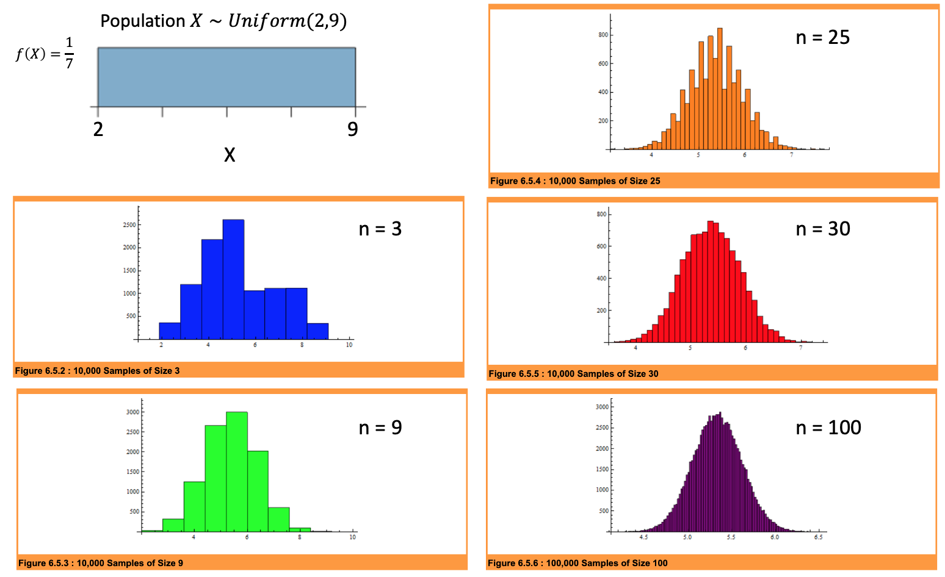
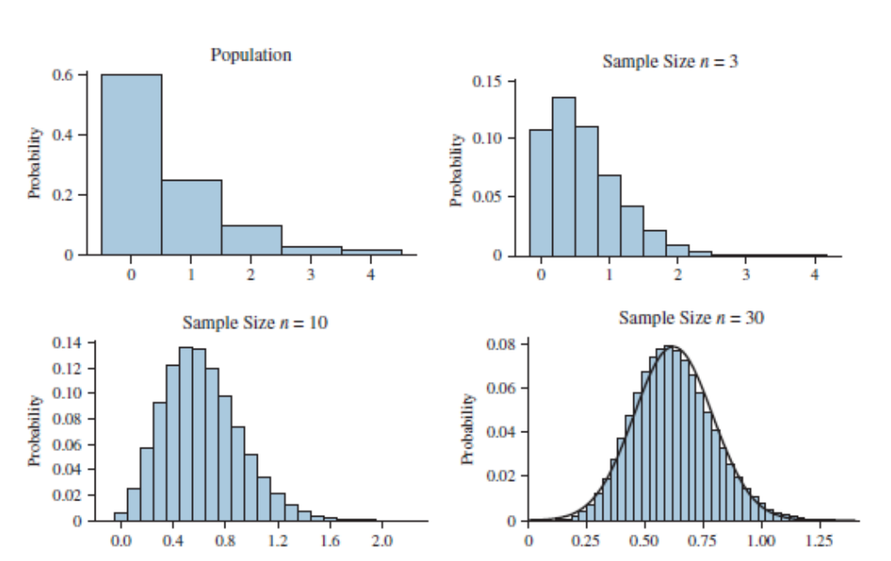
Large Enough Sample Demonstration
Demo A
Demo B
Now we have a skewed population
Interpretation of this demo
Here we see that eventually with a large enough sample, we can overlay a normal curve and it lines up very well!
So if in an application and we have a sample of size 30 from our original population…
We can be confident that our probability calculations that used the CLT results are actually good
Interpretation of this demo
With smaller sample sizes (n = 3, 9), we don’t see the bell shape in the sampling distribution
Which means our sample is toooo small for the results of the CLT to apply
So need a bigger sample size still!
As we increase the sample size, the shape becomes more normal
Which tells us then the conditions were met and we can use the theorem

Slide 22
Example: Capsized Tour Boat
Setup
On October 5, 2005, a tour boat name the Ethan Allen capsized in Lake George in New York with 47 passengers aboard.
The maximum weight capacity of the boat was estimated to be 7500 pounds.
Data from the Centers for Disease Control and Prevention indicates that weights of American adults in 2005 had a mean of 167 pounds and a standard deviation of 35 pounds.
Question
Use this information to estimate the probability that the total weight in a random sample of 47 American adults exceeds 7500 pounds (which translates to an average weight of 7500 lbs / 47 people or 159.574 pounds per person).

Slide 23
Solution
STEP 1: Draw Normal Curve and Label!!! Find new parameters!
STEP 2: Write in terms of a probability statement!!!
STEP 3: Shade the curve
STEP 4: Show work and write answer!
Solve
1) Find / define the distribution of sample means of weights.
2) Find the probability total weight in a random sample of 47 American adults exceeds 7500 pounds.

Slide 24
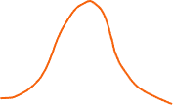

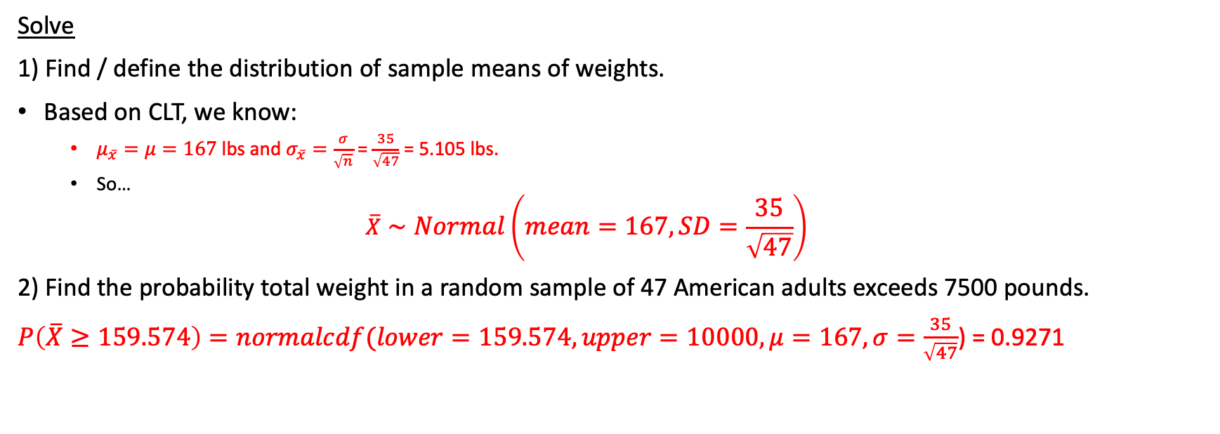
Solution
STEP 1: Draw Normal Curve and Label!!! Find new parameters!
STEP 2: Write in terms of a probability statement!!!
STEP 3: Shade the curve
STEP 4: Show work and write answer!
Solve
1) Find / define the distribution of sample means of weights.
Based on CLT, we know:
$μ_{\overline{x}}=μ=167$ lbs and $σ_{\overline{x}}=\frac{σ}{\sqrt{n}}$ = $\frac{35}{\sqrt{47}}$ = 5.105 lbs.
So…
$$\overline{X}∼Normal\left(mean=167, SD=\frac{35}{\sqrt{47}}\right)$$
2) Find the probability total weight in a random sample of 47 American adults exceeds 7500 pounds.
$P\left(\overline{X}≥159.574\right)=normalcdf(lower=159.574, upper=10000, μ=167, σ=\frac{35}{\sqrt{47}}$) = 0.9271

Slide 25
Proportions!

Slide 26
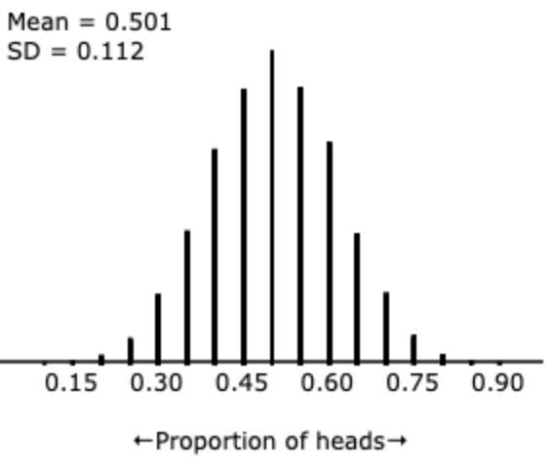
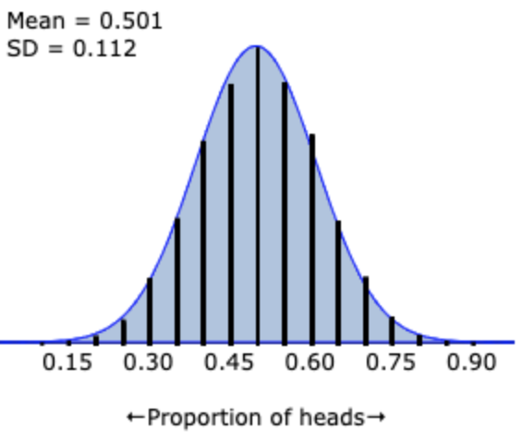
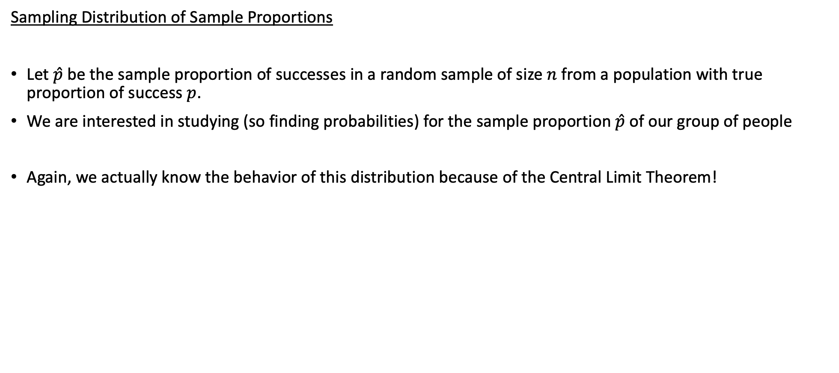
Sampling Distribution of $\hat{p}$
Sampling Distribution of Sample Proportions
Let $\hat{p}$ be the sample proportion of successes in a random sample of size $n$ from a population with true proportion of success $p$.
We are interested in studying (so finding probabilities) for the sample proportion $\hat{p}$of our group of people
Again, we actually know the behavior of this distribution because of the Central Limit Theorem!
Ex) Results from 10,000 samples of 20 coin tosses
→ p = 0.5
Applet!!!

Slide 27
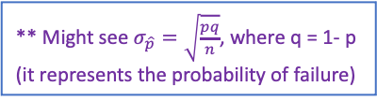
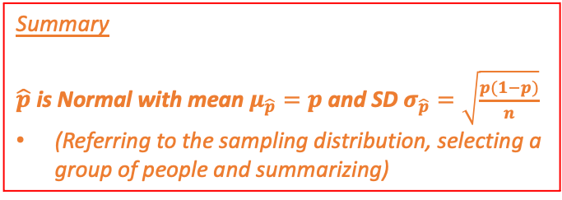
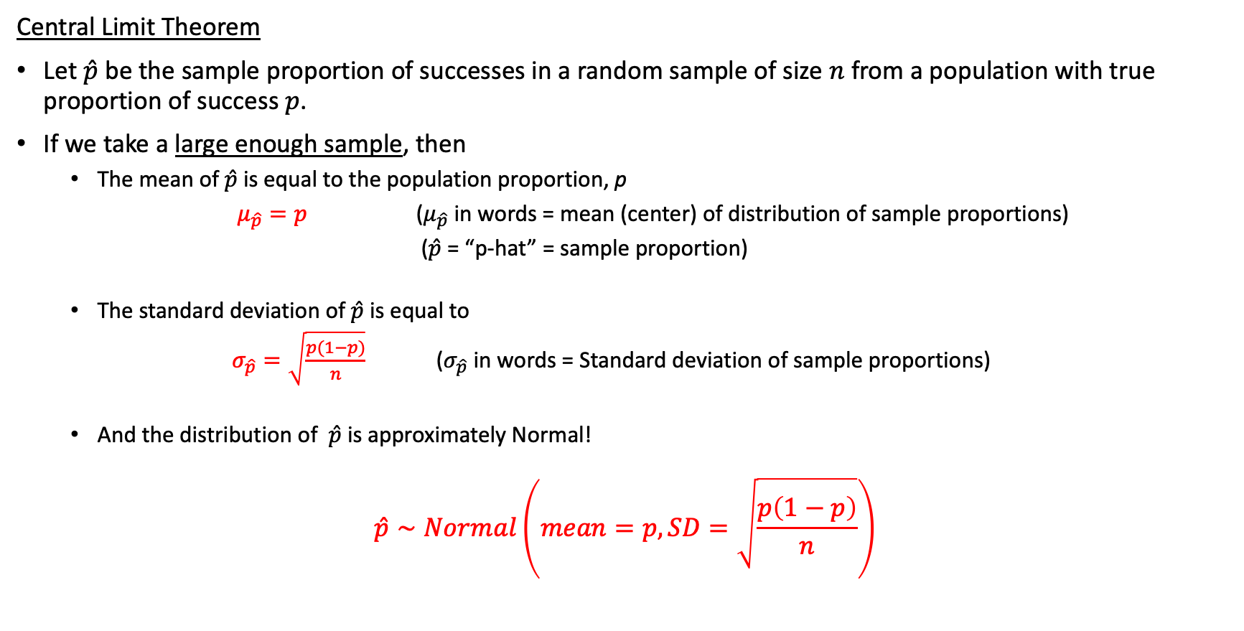
Central Limit Theorem for $\hat{p}$
Central Limit Theorem
Let $\hat{p}$ be the sample proportion of successes in a random sample of size $n$ from a population with true proportion of success $p$.
If we take a large enough sample, then
The mean of$\hat{p}$is equal to the population proportion, p
$μ_{\hat{p}}=p$ ($μ_{\hat{p}}$ in words = mean (center) of distribution of sample proportions)
($\hat{p}$ = “p-hat” = sample proportion)
The standard deviation of$\hat{p}$ is equal to
$σ_{\hat{p}}=\sqrt{\frac{p(1−p)}{n}}$ ($σ_{\hat{p}}$ in words = Standard deviation of sample proportions)
And the distribution of $\hat{p}$ is approximately Normal!
$$\hat{p}∼Normal\left(mean=p, SD=\sqrt{\frac{p\left(1−p\right)}{n}}\right)$$
** Might see $σ_{\hat{p}}=\sqrt{\frac{pq}{n}}$, where q = 1- p (it represents the probability of failure)
Summary
$\hat{p}$is Normal with mean $μ_{\hat{p}}=p$and SD $σ_{\hat{p}}=\sqrt{\frac{p(1−p)}{n}}$
(Referring to the sampling distribution, selecting a group of people and summarizing)
** Again, technically there are conditions for this (same idea, but different because proportions now). But we will ignore them ☺

Slide 28
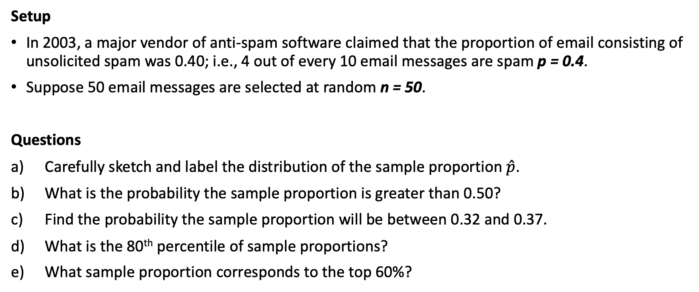
Example: Spam
Setup
In 2003, a major vendor of anti-spam software claimed that the proportion of email consisting of unsolicited spam was 0.40; i.e., 4 out of every 10 email messages are spam p = 0.4.
Suppose 50 email messages are selected at random n = 50.
Questions
Carefully sketch and label the distribution of the sample proportion $\hat{p}$.
What is the probability the sample proportion is greater than 0.50?
Find the probability the sample proportion will be between 0.32 and 0.37.
What is the 80th percentile of sample proportions?
What sample proportion corresponds to the top 60%?

Slide 29
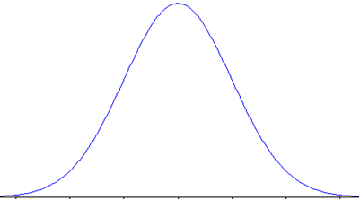
Solution
STEP 1: Draw Normal Curve and Label!!! Find new parameters!
STEP 2: Write in terms of a probability statement!!!
STEP 3: Shade the curve
STEP 4: Show work and write answer!
Setup: Suppose 50 email messages are selected at random (n = 50) with proportion of spam emails p = 0.4.
a) Define and sketch the distribution of sample proportions of spam emails.
b) What is the probability the sample proportion is greater than 0.50?
c) Find the probability the sample proportion will be between 0.32 and 0.37.
d) What is the 80th percentile of sample proportions?
e) What sample proportion corresponds to the top 60%?

Slide 30










Solution
STEP 1: Draw Normal Curve and Label!!! Find new parameters!
STEP 2: Write in terms of a probability statement!!!
STEP 3: Shade the curve
STEP 4: Show work and write answer!
Setup: Suppose 50 email messages are selected at random (n = 50) with proportion of spam emails p = 0.4.
a) Define and sketch the distribution of sample proportions of spam emails.
This is the SAME PROCESS as before, except now with PROPORTIONS instead of MEANS!!
We want to study the sampling distribution of sample proportions $\hat{p}$
So we need to use the CLT formulas to make the adjustments to our original population information
This gives us the information for our NEW curve, $\hat{p}$
Based on CLT, we know:
$μ_{\hat{p}}=p=0.4$and $σ_{\hat{p}}=\sqrt{\frac{p(1−p)}{n}}=\sqrt{\frac{0.4(0.6)}{50}}=0.069≈0.07$ .
So…
$$\hat{p}∼Normal\left(mean=0.4, SD≈0.07\right)$$
Label the curve using the rounded value of the NEW standard deviation
b) What is the probability the sample proportion is greater than 0.50?
Sample proportions, so need to have p-hats and NOT X-bars in our probability statement
Then to use our NEW curve based on CLT formulas, just use the p-hat mean and sd in normalcdf()
Important to keep means vs proportions straight because have are different CLT formulas
P$\left(\hat{p}>0.50\right)$ $=normalcdf(lower=0.5, upper=10000, μ=0.4, σ=\sqrt{\frac{0.4(0.6)}{50}}$) = 0.0744
c) Find the probability the sample proportion will be between 0.32 and 0.37.
Again p-hats because sample proportions, then it’s the same logic as usual
Just like in means, better to type the expression in directly for the SD
P$\left(0.32≤\hat{p}≤0.37\right)$ = $normalcdf(lower=0.32, upper=0.37, μ=0.4, σ=sqrt(0.4∗0.6 / 50$)) = 0.2083
0.19 0.26 0.33 0.40 0.47 0.54 0.61
$$\hat{p}$$
$$\hat{p}$$
$$\hat{p}$$

Slide 31









Solution
STEP 1: Draw Normal Curve and Label!!! Find new parameters!
STEP 2: Write in terms of a probability statement!!!
STEP 3: Shade the curve
STEP 4: Show work and write answer!
Setup: Suppose 50 email messages are selected at random (n = 50) with proportion of spam emails p = 0.4.
NEW curve based on CLT formulas: $\hat{p}∼Normal\left(mean=p=0.4, SD=\sqrt{\frac{p(1−p)}{n}}=\sqrt{\frac{0.4(0.6)}{50}}\right)$
d) What is the 80th percentile of sample proportions?
Sample proportions, so using p-hat (sampling distribution, CLT) info
Remember percentile means % to the left, so want less than < in our statement
We are trying to figure out the $\hat{p}$ value that marks the lower 45%
P($\hat{p}$ < ??) = 0.8 → $\hat{p}$ = invNorm(area = 0.8, mean = 0.4, sd = sqrt(0.4 x 0.6 / 50)) = 0.458
e) What sample proportion corresponds to the top 60%?
Given an upper probability, so need to figure out the left probability for the calc
Then it’s the same process as usual with the p-hat info
P($\hat{p}$> ??) = 0.6 <=== equivalent to ===> P($\hat{p}$< ??) = 1– 0.6 = 0.4
$\hat{p}$ = invNorm(area = 0.4, mean = 0.4, sd = sqrt(0.4 x 0.6 / 50)) = 0.382
0.40
$$\hat{p}$$
0.40
$$\hat{p}$$

Slide 32

Summary
Original Population Info
(an individual)
(Numerical)
X
Categorical
p
NEW Distribution
(a group)
Sample Mean
$\overline{X}$
Sample Proportion
$\hat{p}$
CLT Formulas
Normal with NEW Mean and SD

Slide 33
Problem Session!!!

Slide 34
Practice Problem #1
According to the Gallup Poll, 27% of U.S. adults have high levels of cholesterol. Gallup reports that such elevated levels “could be financially devastating to the U. S. healthcare system” and are a major concern to health insurance providers. According to recent studies, cholesterol levels in health U. S. adults average about 215 ml/Dl with a standard deviation of about 30 mg/DL and are roughly Normally distributed. If the cholesterol levels of a sample of 42 healthy adults is taken,
What shape should the sampling distribution of the mean have?
What would the mean of the sampling distribution be?
What would its standard deviation be?
What is the probability of obtaining a sample mean less than 200 ml/Dl?
What is the probability of obtaining a sample mean between 208 and 220 ml/Dl?
What sample mean cholesterol level is at the 80th percentile?
If the sample size were increased to 100, how would your answers to parts a-c change?

Slide 35




Practice Problem #1 Solution
$μ=215 mg/dL$, $σ=30 mg/dL$, $n=42$
Symmetric, bell-shaped
$μ_{\overline{x}}=215 mg/dL$
$σ_{\overline{x}}=\frac{30}{\sqrt{42}}≈4.6291 mg/dL$
P($\overline{x}$ <= 200) = 0.0006
P(208 <= $\overline{x}$ <= 220) = 0.79476
P($\overline{x}$ <= 218.9) = 0.80
Only the standard deviation of the sampling distribution would change from 4.6291 mg/dL to 3 mg/dL

Slide 36
Problem #1
An investment website can tell what devices are used to access the site. The site managers wonder whether they should enhance the facilities for trading via “smart phones” so they want to estimate the proportion of users who access the site that way (even if they also use their computers sometimes). They draw a random sample of 200 investors from their customers. Suppose that the true proportion of smart phone users was 36%.
What would you expect the shape of the sampling distribution for the sample proportion to be?
What would be the mean of this sampling distribution?
If the sample size were increased to 500, would your answers change? Explain.

Slide 37
Problem #1 Solution
np = 200(0.36) = 72 and nq = 200(1 – 0.36) = 128; Normal
$μ_{\hat{p}}$ = 0.36
$σ_{\hat{p}}=\sqrt{\frac{0.36(1−0.36)}{200}}=0.0339$
$$σ_{\hat{p}}=\sqrt{\frac{0.36(1−0.36)}{500}}=0.0215$$
No, only the standard deviation of the sampling distribution would change; it would decrease from 0.0339 to 0.0215.

Slide 38
Problem #3
The investment website of Exercise 1 draws a random sample of 200 investors from their customers. Suppose that the true proportion of smart phone users is 36%.
What would the standard deviation of the sampling distribution of the proportion of smart phone users be?
What is the probability that the sample proportion of smart phone users is greater than 0.36?
What is the probability that the sample proportion of smart phone users is between 0.30 and 0.40?
What is the probability that the sample proportion of smart phone users is less than 0.28?
What is the probability that the sample proportion of smart phone users is greater than 0.42?

Slide 39
Problem #3 Solution
$σ_{\hat{p}}=\sqrt{\frac{0.36(1−0.36)}{200}}=0.0339$
P($\hat{p}$ > 0.36) = 0.50
P(0.30 < $\hat{p}$ < 0.40) = 0.8426
P($\hat{p}$ < 0.28) = 0.0091
P($\hat{p}$ > 0.42) = 0.0384

Slide 40
Problem #7
A market researcher for a provider of iPod accessories wants to know the proportion of customers who own cars to assess the market for a new iPod car charger. A survey of 500 customers indicates that 76% own cars.
Q: What is the standard deviation of the sampling distribution of the proportion?

Slide 41
Problem #7 Solution
$$σ_{\hat{p}}=\sqrt{\frac{0.15(1−0.15)}{100}}=0.0357$$

